Slide 1

Database Design for Retail Shrinkage Control
A case study on optimizing database systems to reduce inventory losses at Khush-Mart retail chain.
By Avi Malik, Ankush Handa, and Meet Chirag

Slide 2
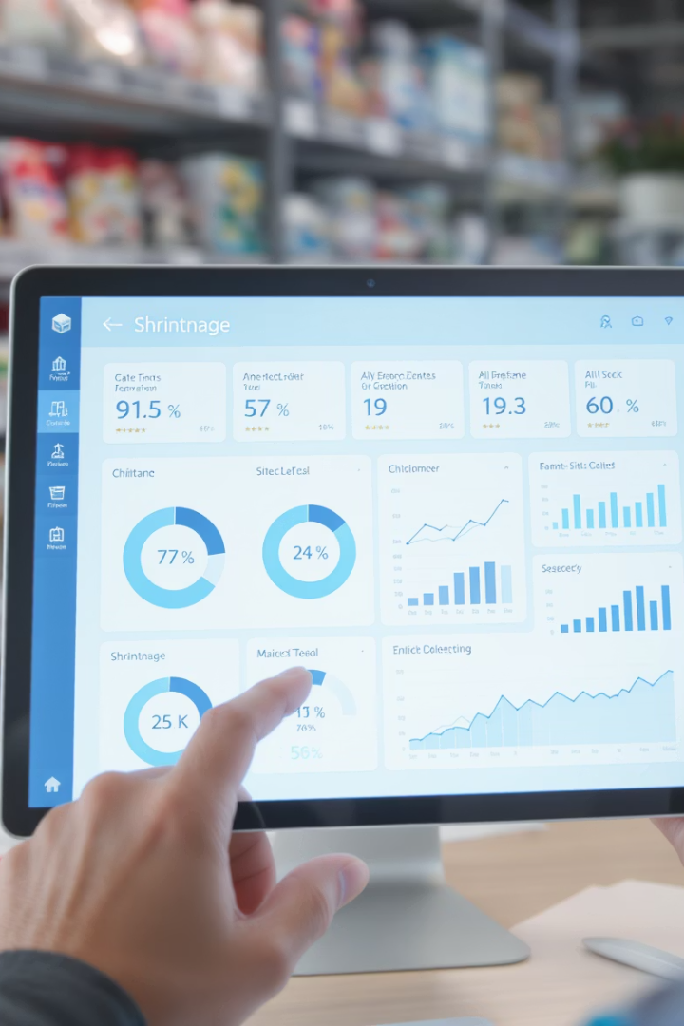
Khush-Mart: Mission & Challenge
Organization
Mission
Khush-Mart: A hypothetical retail chain.
Reduce inventory losses by implementing an improved database system.
Challenge
Control retail shrinkage that impacts profitability and operational efficiency.

Slide 3

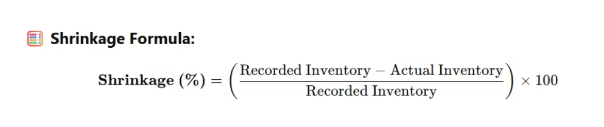
Shrinkage Control Objective
KUSH-MART AIMS TO CONTROL SHRINKAGE TO UNDER 1.5% OF TOTAL SALES VOLUME

Slide 4



Entity Identification
EMPLOYEE_TABLE, PRODUCT_TABLE, CUSTOMER_TABLE, and SUPPLIER_TABLE form the foundation of our database system
SALES_TABLE, INVENTORY_TABLE, and PRODUCT_RETURNS track business operations
THEFT_CASES logs reported incidents and investigation details for loss prevention

Slide 5
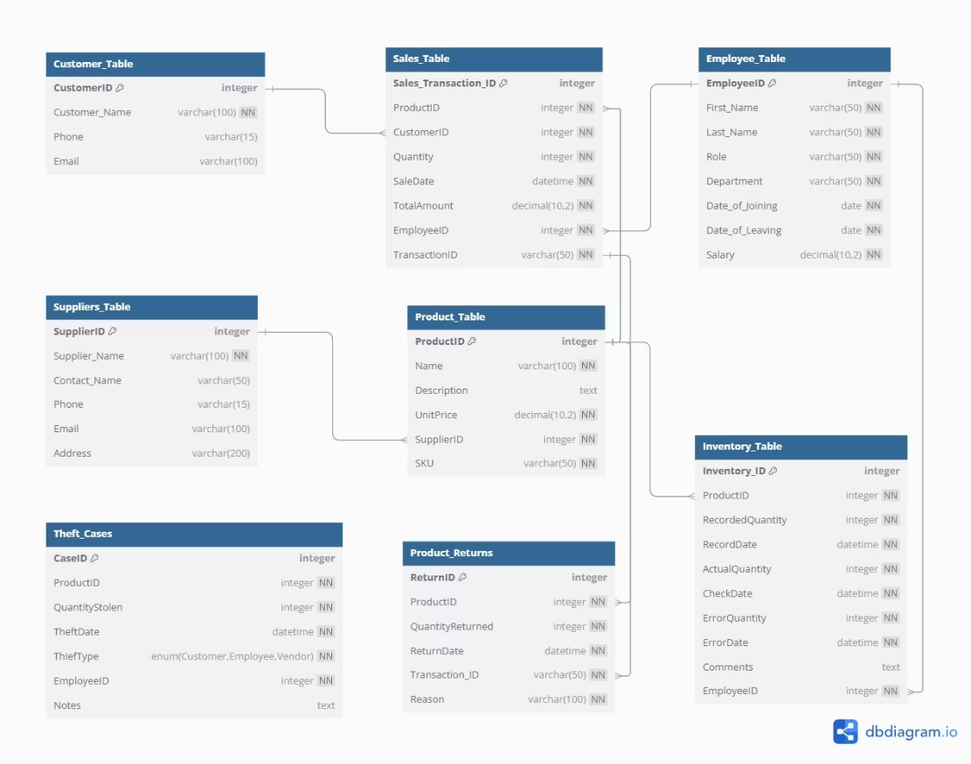
Entity Relationship Diagram

Slide 6
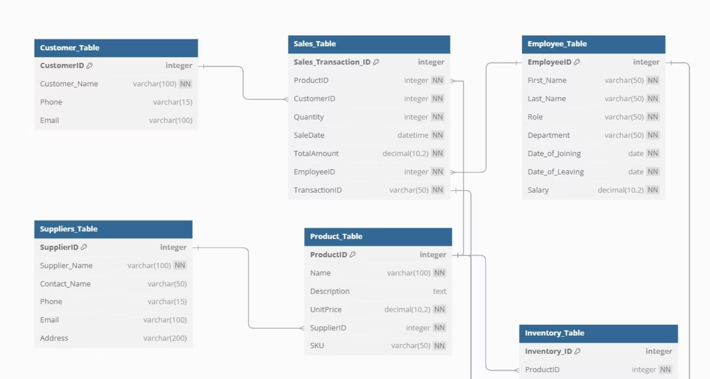
Generic Tables Structure

Slide 7
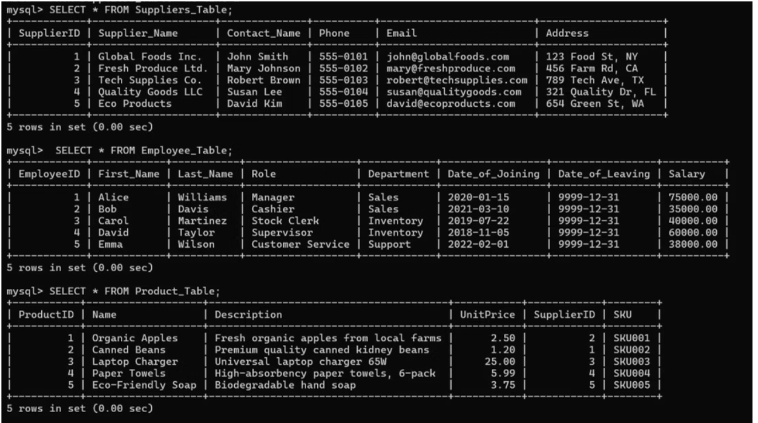
Generic Tables Data View 1

Slide 8
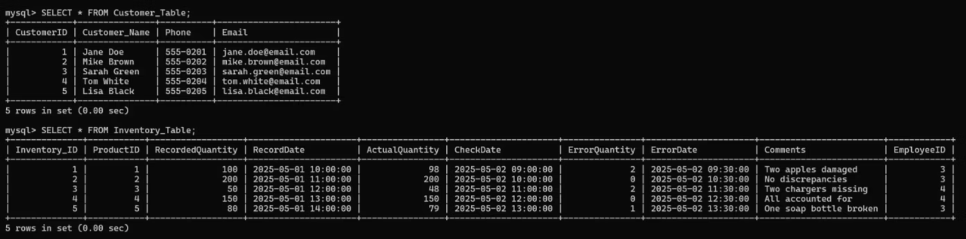
Generic Tables Data View 2
This view presents additional sample data from our core tables, focusing on product and inventory records with essential attributes. The structured format allows for efficient tracking of merchandise movement throughout the supply chain.

Slide 9
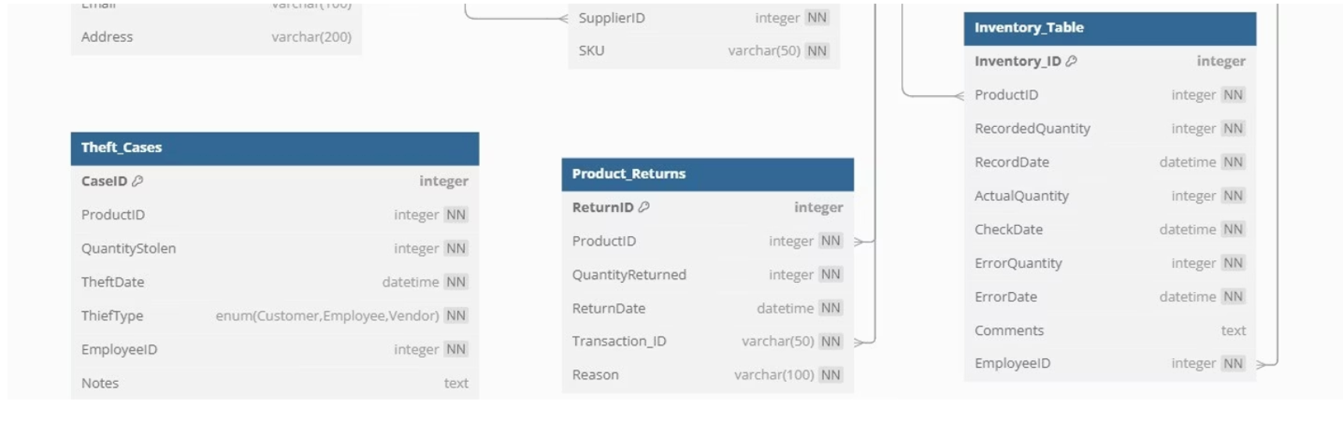
Specialized Loss Prevention Tables
These tables enable Khush-Mart to implement proactive prevention measures through data pattern recognition, allowing management to identify potential issues before significant losses occur.

Slide 10
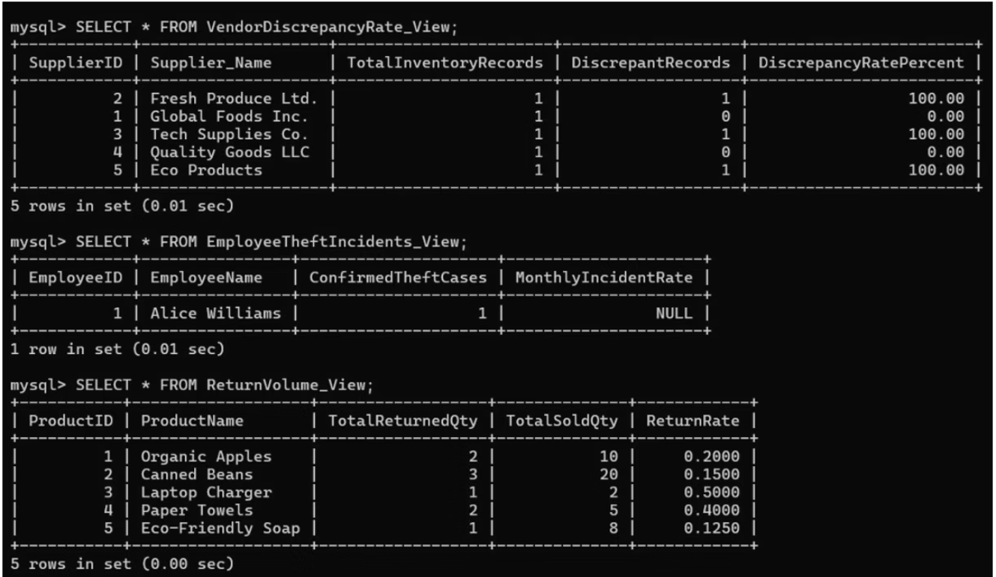
Additional Tables Data View 1

Slide 11
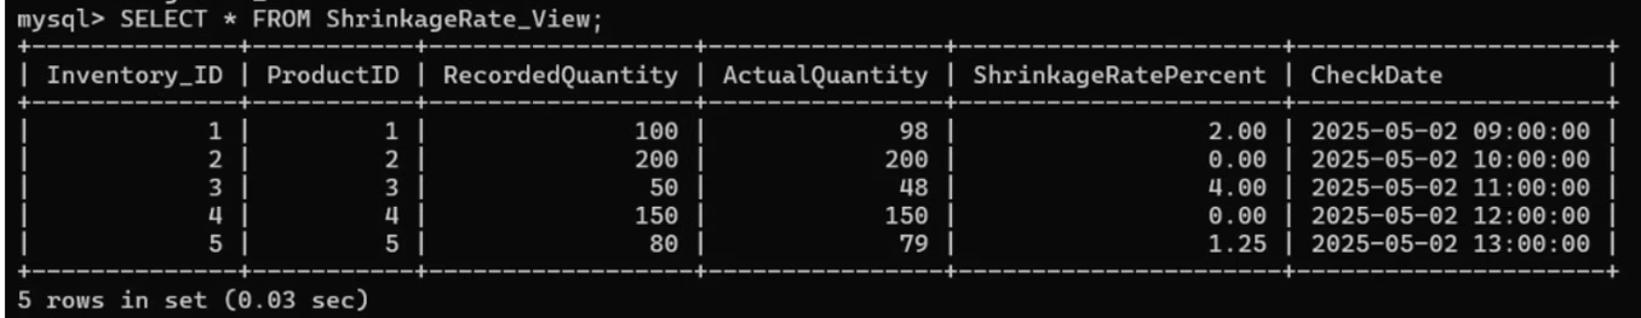
Additional Tables Data View 2
Additional entities support Khush-Mart’s mission to
monitor, analyze, and control retail shrinkage, to under 1.5% of Sales Volume.

Slide 12
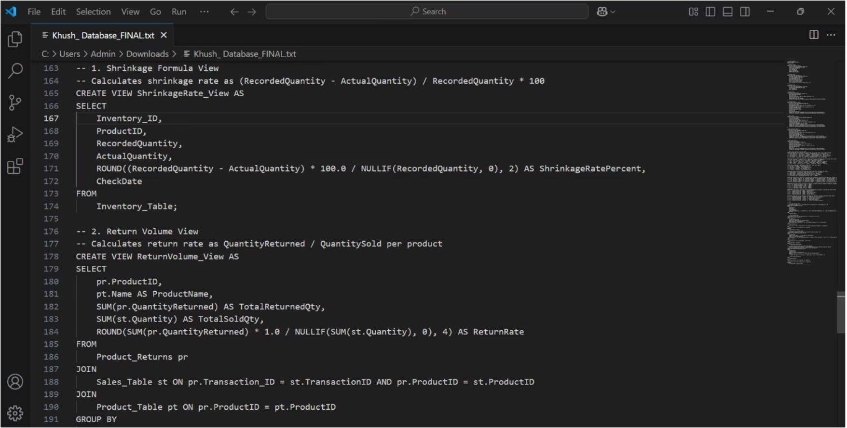
Implementation Code

Slide 13





Documentation & Assumptions
Documentation
Assumptions
Field Naming
Comprehensive entity descriptions provided in previous slides
Shrinkage limited to theft, damage, and inventory errors
Clear, descriptive names for user and developer understanding
Limitations
Loss prevention cost measures not currently tracked

Slide 14

Thank You
Database design by Avi Malik, Ankush Handa, and Meet Chirag

